Slide 1
The update case study

Slide 2

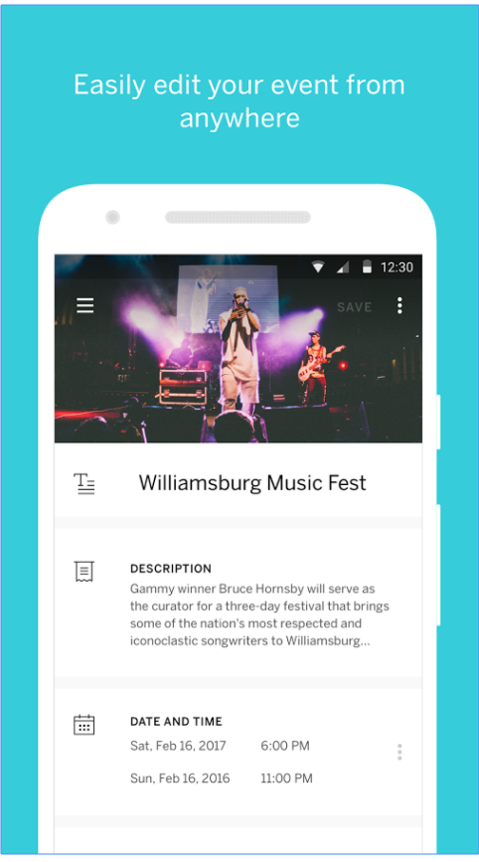
Event organizing applications
Event Organizer (formerly Entry Manager) is the one-stop shop for event management on your Android device. Event planners can now create and edit events, monitor real-time ticket sales, check-in attendees, track attendance live, and quickly accept, secure payment for tickets and merchandise on-site.
The second screen show a day program schedule of the he event

Slide 3
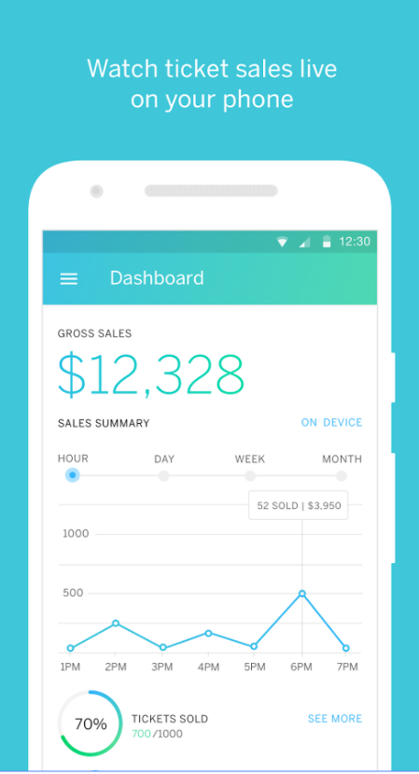
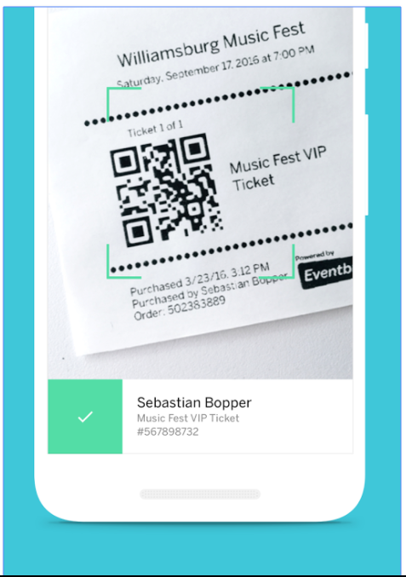
Event organizing applications
This screenshot show us ticket sales live (Online) and Give your guests flawless(perfect) entry experience

Slide 4
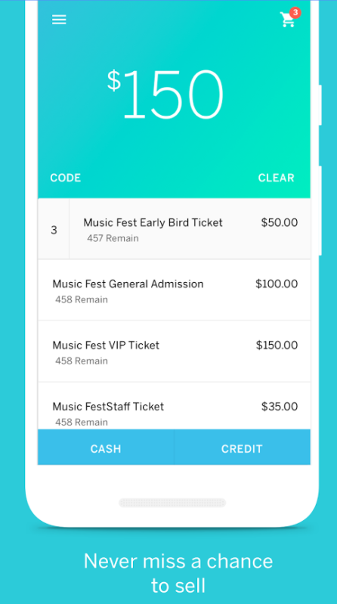
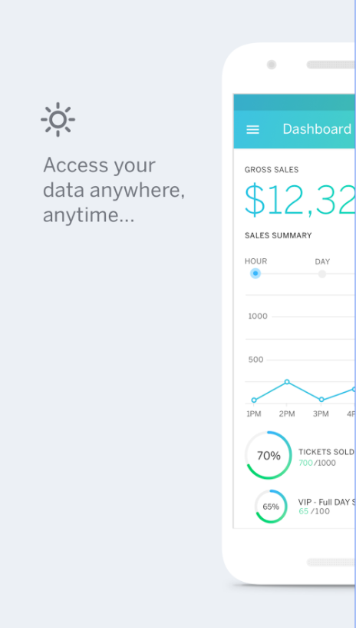
Event organizing applications
This screen show us different type of tickets and access live data anywhere and anytime

Slide 5
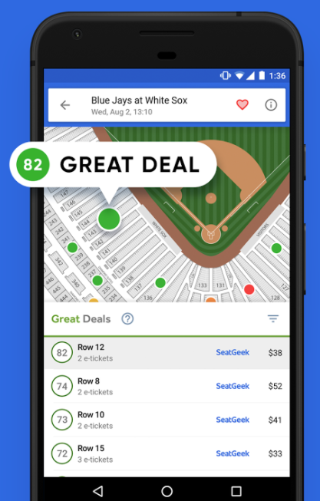
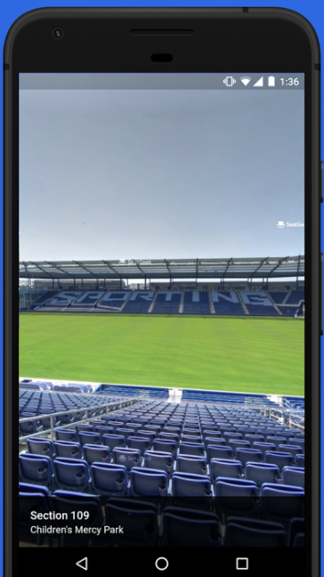
Tickets to Sports, Concerts, Broadway
Ticket to sport is the easiest way to find great deals on tickets to thousands of sporting events (AZAM league, ZONE V, feasa, basket league RWANDA shows

Slide 6
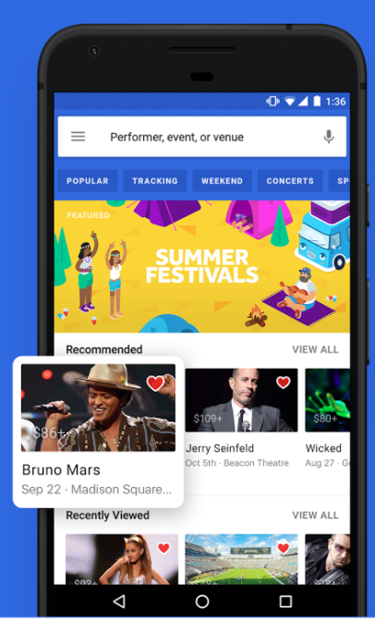
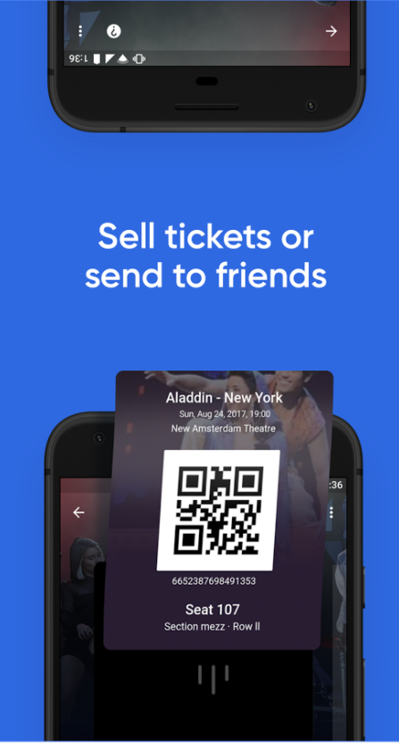
Tickets to Sports, Concerts, Broadway
Ticket to sport is the easiest way to find great deals on tickets to thousands of Concert events (Album lunch,Kwita izina gala dinner,CharynaNina concert, and etc), concerts, festivals, and Broadway/theater like Seka live shows

Slide 7
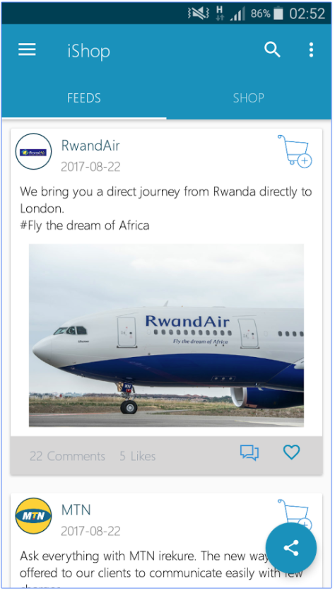
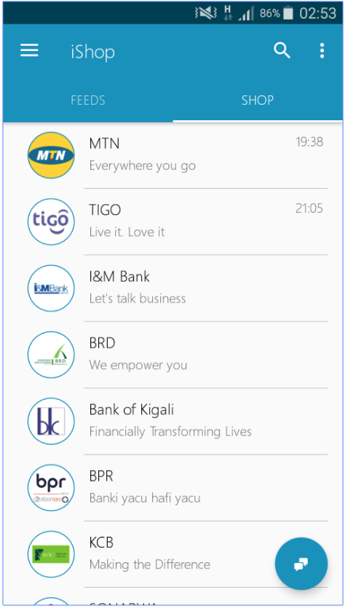
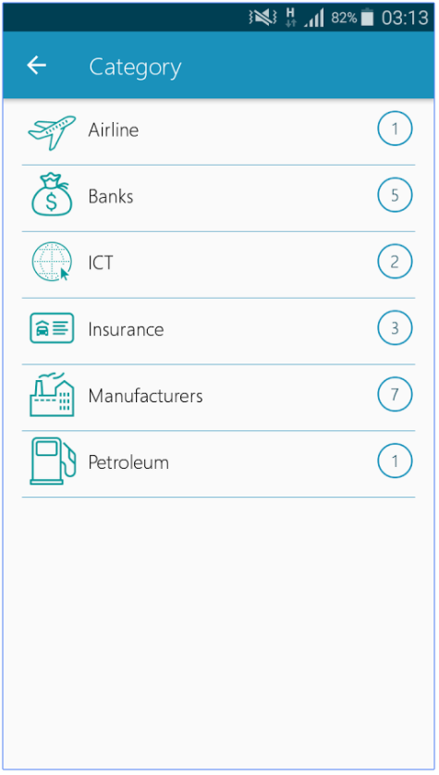
Eshop
Eshop is a Rwandan leading mobile application that connects customers to businesses anytime, anywhere. Eshop customer be able to check what's new on the market and what a service a certain business is offering so that s/he (customer) can be able to order that item by using order option in the app and provide some bit of information about that order.
Feature
Feeds- Providing wall content where user will easily view posted content, liking and comments on that posted item.Sharing: Content sharing so that you can let someone know what posted on the application and and who posted that product.Order- user may be able to order an item using Eshop

Slide 8
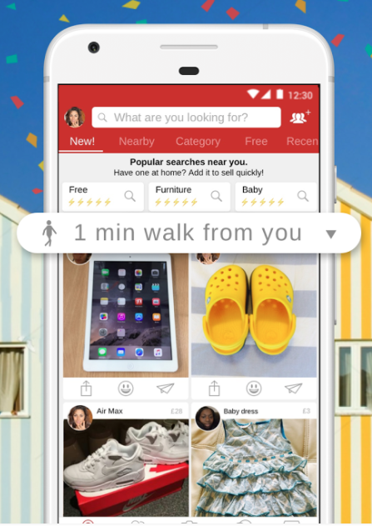
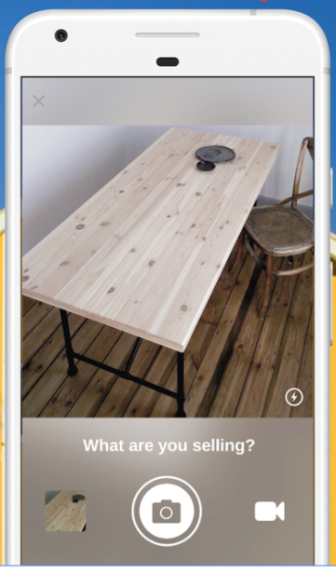
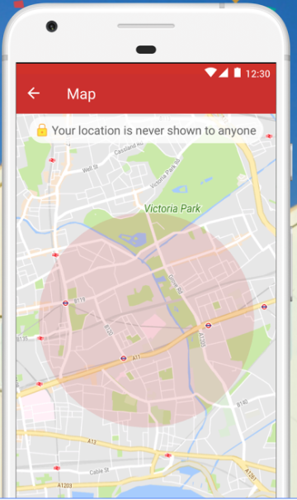
Village - Buy & Sell Locally
Buy, sell & share with people in your neighbourhood - Village is the market on your doorstep
* Everything’s Local 🏡 - - always within walking distance!
* Fastest Way to Sell 📷 add your items in seconds, have them picked up in minutes!
💸 SELL YOUR STUFF 💸
- The fastest way to sell or freecycle preloved stuff and second-hand items - Snap a photo or video, add a description and choose your price, that’s it! - Share with friends on WhatsApp, Facebook, Messenger, Instagram, Twitter, Email or SMS - Make a quick sale with direct chat in the Village app - Manage all your sales in one place - Meet nearby in person to exchange your item for cash!

Slide 9
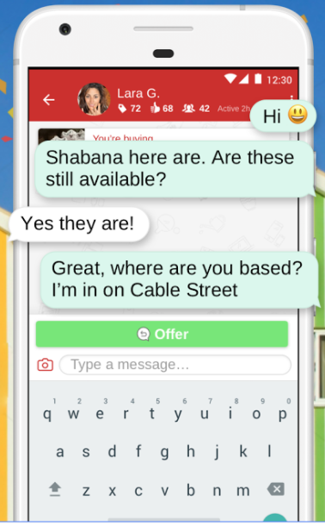
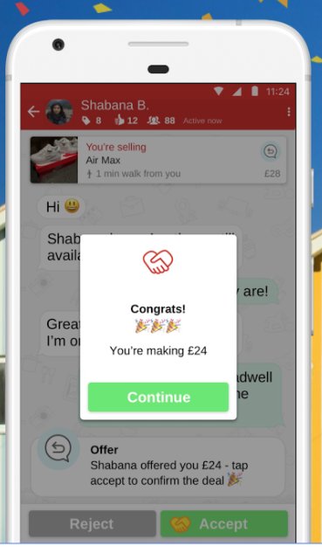
Chat safely with your customer
* Trusted & Safe 😃 - your trusted local community already living next door!
👨‍👩‍👧‍👦 COMMUNITY BUY & SELL GROUPS 👨‍👩‍👧‍👦 - Create a group for your family, fellow parents, people at work or any other group you’re a part of, to buy and sell easily with each other - Chat with fellow members with group chat
We've come together to make Village as we wanted a better and more trustworthy way to connect with our neighbours and local community - we’ve already got everything we need amongst ourselves #YesWeHave

Slide 10
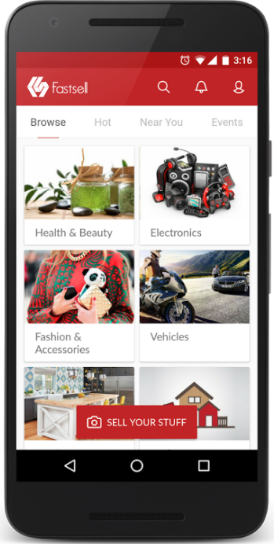
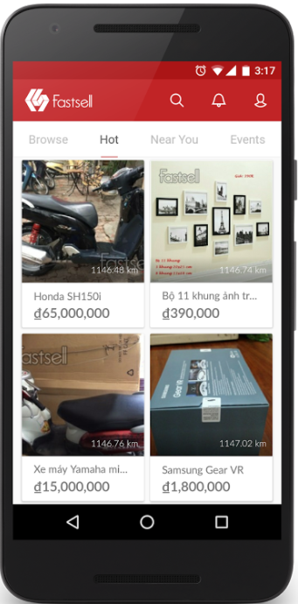
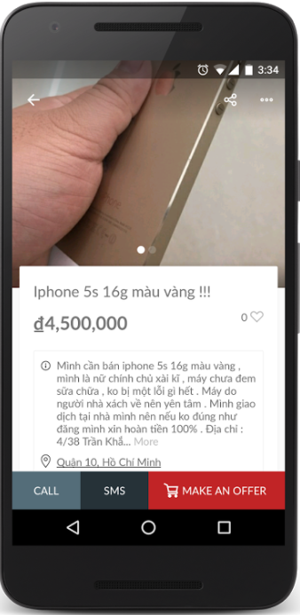
Sell & Buy nearby
EARN CASH EASILY - It's the best opportunity to make money by selling things that you no longer need.
SHOP FOR NEW AND SECOND HAND ITEMS within your neighborhood. If you're a bargain hunter, Fastsell is for you!

